Slide 1
Beans and Configuration

Slide 2
Contents
Beans in Spring Boot
Autowiring in Spring Boot
Working with command-line arguments
Configuration in Spring Boot
Exercise
Annex
Spring Expression Language (SpEL)
Demo project:
DemoBeansAndConfig

Slide 3
1. Beans in Spring Boot
Overview
Defining beans in Spring Boot
Bean scope
Bean instantiation
Accessing beans in Spring Boot
Component scanning in Spring Boot
Fine-tuning component scanning
For the demos in this section, see this package:
demo.beans

Slide 4
Overview
You can define beans in Spring Boot just like you do in normal Spring Framework applications…
As auto-discovered components
@Component
@Service
@Repository
@Controller and @RestController
Via configuration
Java configuration classes
XML configuration files

Slide 5
Defining Beans in Spring Boot
Example of a Spring bean
Via the @Component annotation
Optionally, you can specify the bean's name
Default name is the de-capitalized unqualified class name
package demo.beans;
import org.springframework.stereotype.Component;
import org.springframework.context.annotation.Lazy;
@Component
public class MyBean {
@Override
public String toString() {
return "Hello from MyBean";
}
}
MyBean.java
@Component("myComponent")
public class SomeBean {
…
}

Slide 6
Bean Scope
The default scope (i.e. bean instantiation mode) for beans is singleton
Spring maintains a single instance of the bean
You can specify a different scope:
prototype
request
session
Application
Websocket (spring 5)
Example:
@Component("myComponent")
@Scope("prototype")
public class SomeBean {
…
}

Slide 7
Bean Instantiation
Spring always eagerly creates singleton beans
This can result in (very) slow start-up
You can tell Spring to always lazily-instantiate a bean
Avoids creating a lot of beans that you might never use
Speeds start-up time
To specify lazy loading for a bean:
@Component("myComponent")
@Lazy
public class SomeBean {
…
}

Slide 8
Accessing Beans in Spring Boot
You access beans via the ApplicationContext object
package demo.beans;
import org.springframework.boot.SpringApplication;
import org.springframework.boot.autoconfigure.SpringBootApplication;
import org.springframework.context.ApplicationContext;
@SpringBootApplication
public class Application {
public static void main(String[] args) {
ApplicationContext ctx = SpringApplication.run(Application.class, args);
MyBean bean = ctx.getBean(MyBean.class);
System.out.println(bean);
}
}
Application.java

Slide 9
Component Scanning in Spring Boot
A Spring Boot app automatically scans the current package (and sub-packages) for component classes
This is because @SpringBootApplication incorporates component-scanning behaviour
@Target(value=TYPE)
@Retention(value=RUNTIME)
@Documented
@Inherited
@SpringBootConfiguration
@EnableAutoConfiguration
@ComponentScan
public @interface SpringBootApplication {
Class<?>[] exclude() default {};
String[] excludeName() default {};
@AliasFor(annotation = ComponentScan.class, attribute = "basePackages")
String[] scanBasePackages() default {};
@AliasFor(annotation = ComponentScan.class, attribute = "basePackageClasses")
Class<?>[] scanBasePackageClasses() default {};
}

Slide 10
Fine-Tuning Component Scanning
@SpringBootApplication allows you to fine-tune which packages to scan for components…
scanBasePackages property (String array)
Tells Spring Boot to scan the base packages specified
for scanning
scanBasePackageClasses property (Class array)
Tells Spring Boot to scan the package of each class specified
@SpringBootApplication(
scanBasePackages={"mypackage1", "mypackage2"}
)
public class Application {…}
@SpringBootApplication(
scanBasePackageClasses={mypackage1.MyBean1.class, mypackage2.MyBean2.class}
)
public class Application {…}

Slide 11
2. Autowiring in Spring Boot
Injecting dependencies via @Autowired
Fine-tuning autowiring
Autowiring collections
Injecting values into beans
Specifying values in application properties
Aside: Common application properties
For the demos in this section, see this package:
demo.autowiring

Slide 12
Injecting Dependencies via @Autowired
If a bean has dependencies...
You can annotate with @Autowired in the bean code
You can also use @Inject (as per JSR 330)
Constructor DI
Property setter DI
@Service
public class BankServiceImpl implements BankService {
private BankRepository repository;
@Autowired
BankServiceImpl(BankRepository repository) {
this.repository = repository;
}
…
}
BankServiceImpl.java
@Service
public class BankServiceImpl implements BankService {
@Autowired
private BankRepository repository;
…
}
BankServiceImpl.java

Slide 13
Fine-Tuning Autowiring
You can indicate which particular instance of a bean you want to reference
Use @Qualifier to specify the bean name you want to inject
Disambiguates references
You can mark an @Autowired member as optional
Set required=false
Prevents errors if no matching beans
Also a handy way to specify defaults
@Autowired
@Qualifier("primaryRepository")
private BankRepository repository;
@Autowired(required=false)
private BankRepository repository = new DefaultBankRepositoryImpl();

Slide 14
Autowiring Collections
@Autowired works for collections
Use a typed Collection
Spring injects all beans of that type, which are currently available in the application context
Example
Autowires repositories with a collection of all the beans that implement the BankRepository interface
@Service
public class BankServiceImpl implements BankService {
@Autowired
private List<BankRepository> repositories;
…
}

Slide 15
Injecting Values into Beans
MyBean2.java
You can inject values into beans, via @Value
Use $ to inject an application property value
Use # to inject a general Java value via SpEL (see Annex for info)
package demo.autowiring;
import org.springframework.beans.factory.annotation.Value;
…
@Component
public class MyBeanWithValues {
@Value("${name}") // Inject value of "name" application property.
private String name;
@Value("#{ 5 * 7.5 }") // Inject general Java value via SpEL.
private double workingWeek;
@Override
public String toString() {
return String.format(
"Hello from MyBeanWithValues, name %s, working week %.2f",
name, workingWeek);
}
}
MyBeanWithValues.java

Slide 16
Specifying Values in Application Properties
You can define values in the application properties file
Here's how to access the bean in the main code
application.properties
name=John Smith
package demo.autowiring;
@SpringBootApplication
public class Application {
public static void main(String[] args) {
ApplicationContext ctx = SpringApplication.run(Application.class, args);
…
MyBeanWithValues beanWithValues = ctx.getBean(MyBeanWithValues.class);
System.out.println(beanWithValues);
}
}
Application.java

Slide 17
Aside: Common Application Properties
Spring Boot defines lots of common application properties by default - you can see the full list here:
https://docs.spring.io/spring-boot/docs/current/reference/html/common-application-properties.html
You can override any of these property values if your like
Define your new property values in application.properties or application.yml file (see later for more info about YAML)

Slide 18
3. Working with Command-Line Arguments
Overview
Two types of command-line arguments
Passing command-line arguments in STS
Accessing command-line arguments
Example
For the demos in this section, see this package:
demo.commandlineargs

Slide 19
Overview
Here's a reminder of how we've been bootstrapping our Spring Boot applications
Note we pass args into SpringApplication.run()
When you pass the command-line arguments into run(), you can autowire them into components
public static void main(String[] args) {
ApplicationContext ctx = SpringApplication.run(Application.class, args);
…
}
@Component
public class MyBeanWithArgs {
@Autowired
public MyBeanWithArgs(ApplicationArguments args) {
// You can access command-line arguments here…
}
…
}
MyBeanWithArgs.java

Slide 20
Two Types of Command-Line Arguments
Spring Boot supports two types of command-line args…
Option arguments, prefixed by --
An option argument has a name and value(s)
E.g. here are 2 option arguments (target and db):
Non-option arguments, not prefixed by --
A non-option argument just has a value
E.g. here are 4 non-option arguments:
--target=windows --target=linux --target=osx --db=oracle
norway oslo krone -1

Slide 21
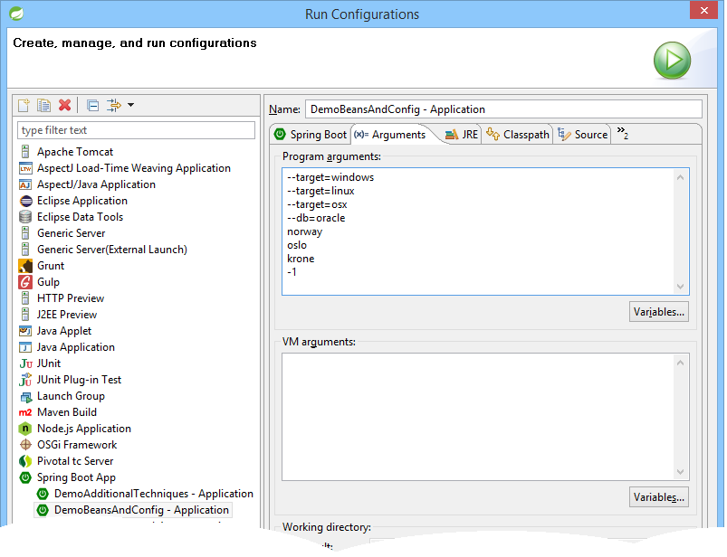
Passing Command Line Arguments in STS
Here's how to pass command-line args using STS

Slide 22
Accessing Command-Line Arguments
The ApplicationArguments class has various methods that enable you to access command-line arguments…
getSourceArgs()
Gets all arguments as raw (unprocessed) strings, as a String[]
getOptionNames()
Gets the names of all the option arguments, as a Set<String>
getOptionValues(optionName)
Gets all the values for a specified option argument
getNonOptionArgs()
Gets all the non-option arguments, as a List<String>

Slide 23
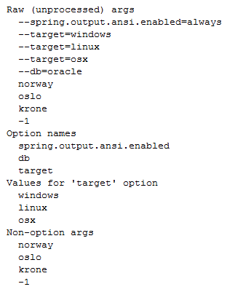
Example
@Component
public class MyBeanWithArgs {
@Autowired
public MyBeanWithArgs(ApplicationArguments args) {
System.out.println("Raw (unprocessed) args");
for (String sourceArg : args.getSourceArgs()) {
System.out.println(" " + sourceArg);
}
System.out.println("Option names");
for (String optName : args.getOptionNames()) {
System.out.println(" " + optName);
}
System.out.println("Values for 'target' option");
if (args.containsOption("target")) {
for (String optValue : args.getOptionValues("target")) {
System.out.println(" " + optValue);
}
}
System.out.println("Non-option args");
for (String nonOptArg : args.getNonOptionArgs()) {
System.out.println(" " + nonOptArg);
}
}
}
MyBeanWithArgs.java

Slide 24
4. Configuration in Spring Boot
Defining a configuration class
Location of configuration classes
Defining beans in a Spring Boot application class
Customizing bean names
Looking-up named beans
Injecting dependencies
Additional techniques
Importing configurations
For the demos in this section, see this package:
demo.configuration

Slide 25
Defining a Configuration Class
You can define a configuration class, which creates bean instances for use in the application
Define a class annotated with @Configuration
Implement methods annotated with @Bean, to return beans
package demo.configuration;
import org.springframework.context.annotation.Bean;
import org.springframework.context.annotation.Configuration;
@Configuration
public class ConfigSimple {
@Bean
public MyBean myBean() {
return new MyBean();
}
}
ConfigSimple.java

Slide 26
Location of Configuration Classes
You can put configuration classes in the same package (or sub-package) as your Spring Boot app class
This is because of the @SpringBootApplication annotation on your Spring Boot app class…
@SpringBootApplication incorporates @ComponentScan
Configuration classes are special kinds of components, so they'll be detected by Spring Boot component scanning
@ComponentScan …
public @interface SpringBootApplication { … }

Slide 27
Defining Beans in a Spring Boot App Class
You can define beans inside your Spring Boot app class
In fact, this is quite common practice
This is because of the @SpringBootApplication annotation on your Spring Boot app class…
@SpringBootApplication incorporates @Configuration
@SpringBootApplication
public class Application {
public static void main(String[] args) {
ApplicationContext ctx = SpringApplication.run(Application.class, args);
…
}
@Bean
public MyBean myBean() {
return new MyBean();
}
// etc.
}
@Configuration …
public @interface SpringBootApplication { … }

Slide 28
Customizing Bean Names
By default, the bean name is the same as the method name
If you like, you can specify a different name for the bean
Set the name property in the @Bean annotation
Specify a single name, or an array of aliases
@Configuration
public class ConfigAdvanced {
@Bean(name = "cool-bean")
public SimpleService mySimpleService1() {…}
@Bean(name = {"subsystemA-bean", "subsystemB-bean", "subsystemC-bean"})
public SimpleService mySimpleService2() {…}
…
}
ConfigAdvanced.java

Slide 29
Looking-Up Named Beans
To look up beans by their name(s):
Call getBean()
Specify the name of the bean you want
private static void demoAdvancedJavaConfig(ApplicationContext ctx) {
// Lookup 1st bean via its name.
SimpleService refBean1 = ctx.getBean("cool-bean", SimpleService.class);
refBean1.doSomething();
// Lookup 2nd bean via its various aliases.
SimpleService refBean2a = ctx.getBean("subsystemA-bean", SimpleService.class);
SimpleService refBean2b = ctx.getBean("subsystemB-bean", SimpleService.class);
SimpleService refBean2c = ctx.getBean("subsystemC-bean", SimpleService.class);
refBean2a.doSomething();
refBean2b.doSomething();
refBean2c.doSomething();
…
}
Application.java

Slide 30
Injecting Dependencies
You can wire-up dependencies between beans as follows:
@Configuration
public class ConfigAdvanced {
…
@Bean(name = "bankservice-bean")
public BankService myBankService() {
return new BankServiceImpl(myRepository());
}
@Bean(name = "bankrepository-bean")
public Repository myRepository() {
return new RepositoryImpl();
}
ConfigAdvanced.java

Slide 31
Additional Techniques
You can set the scope of a bean
You can specify that all singleton beans in a configuration class should be instantiated lazily
@Configuration
public class ConfigAdvanced {
@Bean
@Scope("prototype")
public SimpleService mySimpleService3() { … }
…
}
@Configuration
@Lazy
public class SomeConfigurationClass { … }

Slide 32
Importing Configurations
A configuration class can import another configuration class via @Import
A configuration class can import an XML configuration file (if you have any!) via @ImportResource
@Configuration
@Import(SomeOtherConfig.class)
public class MyConfig {
…
}
@Configuration
@ImportResource("SomeOtherConfig.xml")
public class MyConfig {
…
}

Slide 33
Any Questions?

Slide 34

Exercise - Overview
In this exercise, you'll implement an online retailer Spring Boot application
Import the StudentOnlineRetailer project to get you started
Overview (see details on following slides):
Define a repository bean that stores items for a user's shopping cart
Define a service bean that lets a customer choose items from a catalog, and add to cart
Write client code to utilize the service bean
Solution: SolutionBeansAndConfig

Slide 35
Exercise - Step 1
Define a repository bean that stores items for a user's shopping cart
Hints:
Name the class CartRepository
Define a Map<Integer,Integer> - the keys are the item IDs, and the values are the quantity of each item
Define add(), remove(), getAll() methods

Slide 36
Exercise - Step 2
Define a service bean that lets a customer choose items from a catalog, and add to their shopping cart
Hints:
Name the class CartService
Autowire-in a CartRepository bean
Define a Map<Integer,Item> to hold all the available catalog items (indexed by ID) - you can use the Item class in the student folder
Define methods to add/remove items in cart
Define methods to get all items in cart, and to calculate the total cost of all the items

Slide 37
Exercise - Step 3
Write client code to utilize the service bean
Hints:
Get a reference to the CartService bean from the Spring Boot application context
Invoke various methods on the CartService bean, to add/remove/query items in the customer's shopping cart

Slide 38
Exercise - Step 4 (If Time Permits)
In the main application class:
Define a "bean method" named catalog()
Implement the "bean method" so that it creates and populates a Map<Integer,Item> holding all the items in the catalog
Then in the CartService class:
Autowire-in the catalog bean you just created in the application class
Run the application again, to verify your service is picking up the catalog items correctly

Slide 39
Annex: Spring Expression Language
Where can you use SpEL?
Simple SpEL example
SpEL scalar expressions
Using SpEL for collections
Using SpEL for fields/properties
Using SpEL for parameters
For the demos in this section, see this package:
demo.spel

Slide 40
Where Can You Use SpEL?
You can use SpEL across all the products in the Spring portfolio
In beans, via @Value annotations on fields/values
On parameters in autowired methods
Within XML configuration files
Etc.

Slide 41
Simple SpEL Example
Here's a simple SpEL example in a Java bean
You can use the following types of literals in SpEL:
Strings, dates, numeric values, boolean, and null
Strings are 'xxx', not "xxx" (for a literal quote, use two ')
@Component
@Scope("prototype")
public class SpelBean {
@Value("#{ 5 * 7.5 }")
private double workingWeek;
…
}
SpelBean.java

Slide 42
SpEL Scalar Expressions
These examples illustrate scalar SpEL techniques
Calling a constructor to create a new object
Calling a static method via the T(…) syntax (T for "type" here)
Performing arbitrary operations
@Value("#{ new java.util.Date() }")
private Date timestamp;
@Value("#{ T(java.lang.Math).random() * 100.0 }")
private int luckyNumber;
@Value("Today #{T(java.lang.Math).random() > 0.5 ? 'is' : 'is not'} your lucky day!")
private String message;
SpelBean.java

Slide 43
Using SpEL for Collections (1 of 2)
You can use SpEL to access array/collection/map items
@SpringBootApplication
public class Application {
…
@Bean
public List<String> cities() {
List<String> cities = new ArrayList<>();
cities.add("Aberdeen");
…
return cities;
}
@Bean
public Map<String, String> currencies() {
Map<String, String> currencies = new HashMap<>();
currencies.put("UK", "GBP");
…
return currencies;
}
}
Application.java
@Value("#{ cities[9] }")
private String city;
@Value("#{ currencies['UK'] }")
private String currency;
SpelBean.java

Slide 44
Using SpEL for Collections (2 of 2)
SpEL provides various operators for processing items in arrays/collections/maps
@Value("#{ cities.?[startsWith('B')] }")
private List<String> allBCities;
@Value("#{ cities.^[startsWith('B')] }")
private String firstBCity;
@Value("#{ cities.$[startsWith('B')] }")
private String lastBCity;
@Value("#{ cities.![toUpperCase()] }")
private List<String> upperCities;
@Value("#{ cities.?[matches('^Aber.*')] }")
private List<String> matchCities;
SpelBean.java

Slide 45
Using SpEL for Parameters
You can also use SpEL for parameters on autowired methods/constructors
Annotate method/constructor with @Autowired
Annotate parameter(s) with @Value and specify an SpEL expression value
Example
Evaluates user name and assigns it to the parameter
@Component
@Scope("prototype")
public class SpelBean {
private String userName;
@Autowired
public void setUserName(@Value("#{systemProperties['user.name'] }") String n) {
this.userName = userName;
}
…
}
SpelBean.java

